Slide 1
Chapter 25
Configuration Management

Slide 2
Configuration management
Managing the products of system change

Slide 3
Objectives
To explain the importance of software configuration management (CM)
To describe key CM activities namely CM planning, change management, version management and system building
To discuss the use of CASE tools to support configuration management processes

Slide 4
Topics covered
Configuration management planning
Change management
Version and release management
System building
CASE tools for configuration management

Slide 5
Configuration management
New versions of software systems are created as they change
For different machines/OS
Offering different functionality
Tailored for particular user requirements
Configuration management is concerned with managing evolving software systems
System change is a team activity
CM aims to control the costs and effort involved in making changes to a system

Slide 6
Configuration management
Involves the development and application of procedures and standards to manage an evolving software product
May be seen as part of a more general quality management process
When released to CM, software systems are sometimes called baselines as they are a starting point for further development

Slide 7
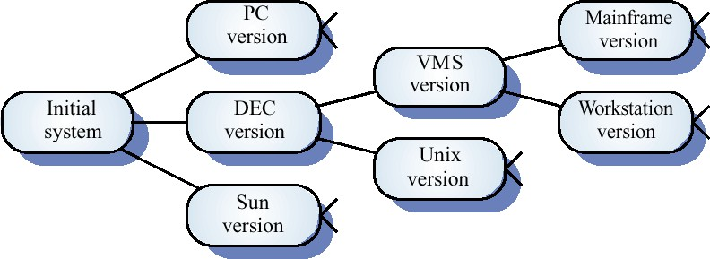
System families

Slide 8
CM standards
CM should always be based on a set of standards which are applied within an organisation
Standards should define how items are identified, how changes are controlled and how new versions are managed
Standards may be based on external CM standards (e.g. IEEE standard for CM)
Existing standards are based on a waterfall process model - new standards are needed for evolutionary development

Slide 9
Concurrent development and testing
A time for delivery of system components is agreed
A new version of a system is built from these components by compiling and linking them
This new version is delivered for testing using pre-defined tests
Faults that are discovered during testing are documented and returned to the system developers

Slide 10
Daily system building
It is easier to find problems that stem from component interactions early in the process
This encourages thorough unit testing - developers are under pressure not to ‘break the build’
A stringent change management process is required to keep track of problems that have been discovered and repaired

Slide 11
Configuration management planning
All products of the software process may have to be managed
Specifications
Designs
Programs
Test data
User manuals
Thousands of separate documents are generated for a large software system

Slide 12
CM planning
Starts during the early phases of the project
Must define the documents or document classes which are to be managed (Formal documents)
Documents which might be required for future system maintenance should be identified and specified as managed documents

Slide 13
The CM plan
Defines the types of documents to be managed and a document naming scheme
Defines who takes responsibility for the CM procedures and creation of baselines
Defines policies for change control and version management
Defines the CM records which must be maintained

Slide 14
The CM plan
Describes the tools which should be used to assist the CM process and any limitations on their use
Defines the process of tool use
Defines the CM database used to record configuration information
May include information such as the CM of external software, process auditing, etc.

Slide 15
Configuration item identification
Large projects typically produce thousands of documents which must be uniquely identified
Some of these documents must be maintained for the lifetime of the software
Document naming scheme should be defined so that related documents have related names.
A hierarchical scheme with multi-level names is probably the most flexible approach

Slide 16
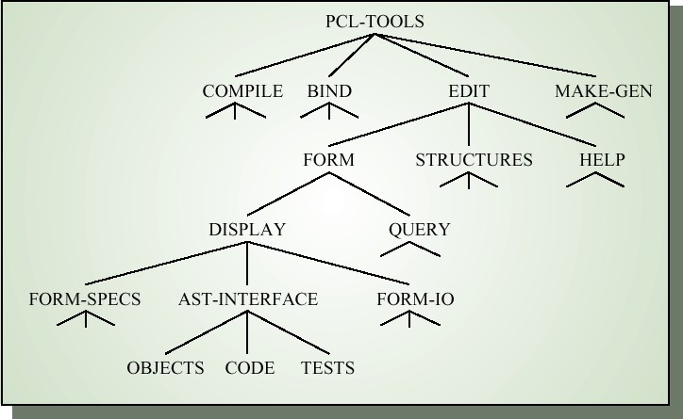
Configuration hierarchy

Slide 17
The configuration database
All CM information should be maintained in a configuration database
This should allow queries about configurations to be
answered
Who has a particular system version?
What platform is required for a particular version?
What versions are affected by a change to component X?
How many reported faults in version T?
The CM database should preferably be linked to the software being managed

Slide 18
CM database implementation
May be part of an integrated environment to support software development. The CM database and the managed documents are all maintained on the same system
CASE tools may be integrated with this so that there is a close relationship between the CASE tools and the CM tools
More commonly, the CM database is maintained separately as this is cheaper and more flexible

Slide 19
Change management
Software systems are subject to continual change requests
From users
From developers
From market forces
Change management is concerned with keeping managing of these changes and ensuring that they are implemented in the most cost-effective way

Slide 20
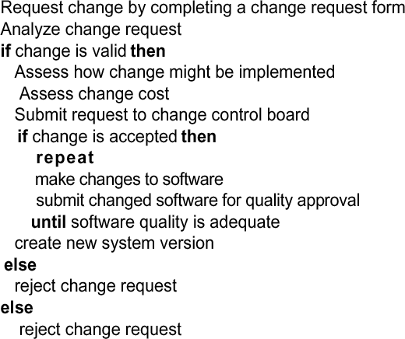
The change management process

Slide 21
Change request form
Definition of change request form is part of the CM planning process
Records change required, suggestor of change, reason why change was suggested and urgency of change(from requestor of the change)
Records change evaluation, impact analysis, change cost and recommendations (System maintenance staff)

Slide 22
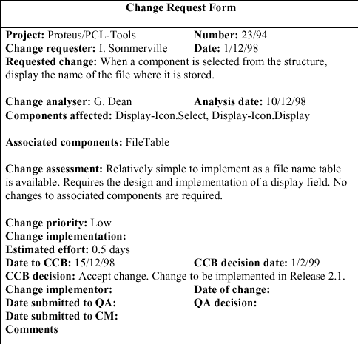
Change request form

Slide 23
Change tracking tools
A major problem in change management is tracking change status
Change tracking tools keep track the status of each change request and automatically ensure that change requests are sent to the right people at the right time.
Integrated with E-mail systems allowing electronic change request distribution

Slide 24
Change control board
Changes should be reviewed by an external group who decide whether or not they are cost- effective from a strategic and organizational viewpoint rather than a technical viewpoint
Should be independent of project responsible for system. The group is sometimes called a change control board
May include representatives from client and contractor staff

Slide 25
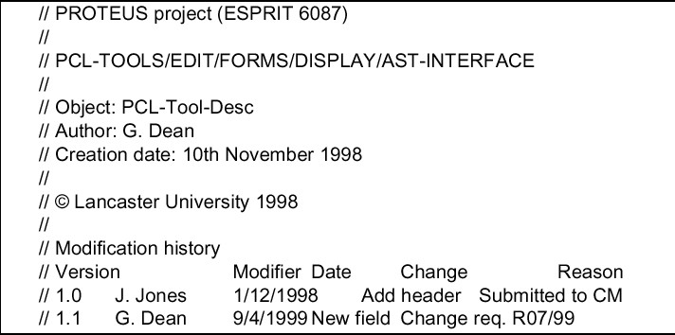
Component header information

Slide 26
Version and release management
Invent identification scheme for system versions
Plan when new system version is to be produced
Ensure that version management procedures and tools are properly applied
Plan and distribute new system releases

Slide 27
Versions/variants/releases
Version An instance of a system which is functionally distinct in some way from other system instances
Variant An instance of a system which is functionally identical but non-functionally distinct from other instances of a system
Release An instance of a system which is distributed to users outside of the development team

Slide 28
Version identification
Procedures for version identification should define an unambiguous way of identifying component versions
Three basic techniques for component identification
Version numbering
Attribute-based identification
Change-oriented identification

Slide 29
Version numbering
Simple naming scheme uses a linear derivation
e.g. V1, V1.1, V1.2, V2.1, V2.2 etc.
Actual derivation structure is a tree or a network rather than a sequence
Names are not meaningful.
Hierarchical naming scheme may be better

Slide 30
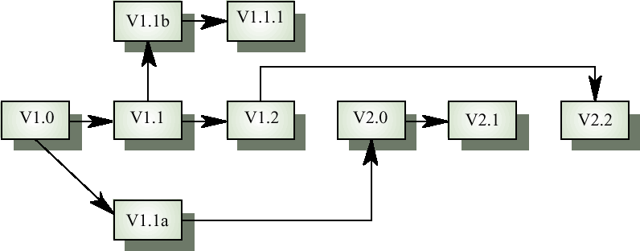
Version derivation structure

Slide 31
Attribute-based identification
Attributes can be associated with a version with the combination of attributes identifying that version
Examples of attributes are Date, Creator, Programming Language, Customer, Status etc.
More flexible than an explicit naming scheme for version retrieval; Can cause problems with uniqueness
Needs an associated name for easy reference

Slide 32
Attribute-based queries
An important advantage of attribute-based identification is that it can support queries so that you can find ‘the most recent version in Java’ etc.
Example
AC3D (language =Java, platform = NT4, date = Jan 1999)

Slide 33
Change-oriented identification
Integrates versions and the changes made to create these versions
Used for systems rather than components
Each proposed change has a change set that describes changes made to implement that change
Change sets are applied in sequence so that, in principle, a version of the system that incorporates an arbitrary set of changes may be created

Slide 34
Release management
Releases must incorporate changes forced on the system by errors discovered by users and by hardware changes
They must also incorporate new system functionality
Release planning is concerned with when to issue a system version as a release

Slide 35
Release Plan for 4 Sprints
XYZTECH is updating its software application through 4 planned sprints, focusing on the most important tasks first. A new app version is delivered at the end of each sprint, but updates are released to users after every 2 sprints. Prepare a release plan showing the number of app versions and releases by the end of the 4th sprint, detailing the work included in each.

Slide 36
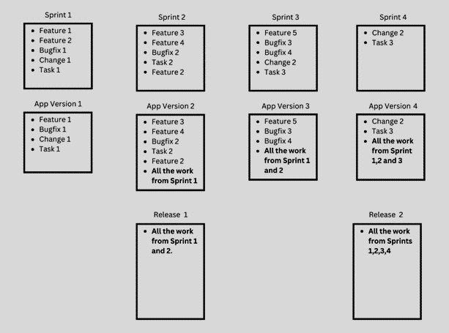

Slide 37
System releases
Not just a set of executable programs
May also include
Configuration files defining how the release is configured for a
particular installation
Data files needed for system operation
An installation program or shell script to install the system on target hardware
Electronic and paper documentation
Packaging and associated publicity
Systems are now normally released on CD-ROM or as downloadable installation files from the web

Slide 38
Release problems
Customer may not want a new release of the system
They may be happy with their current system as the new
version may provide unwanted functionality
Release management must not assume that all previous releases have been accepted. All files required for a release should be re-created when a new release is installed

Slide 39
Release decision making
Preparing and distributing a system release is an expensive process
Factors such as the technical quality of the system, competition, marketing requirements and customer change requests should all influence the decision of when to issue a new system release

Slide 40
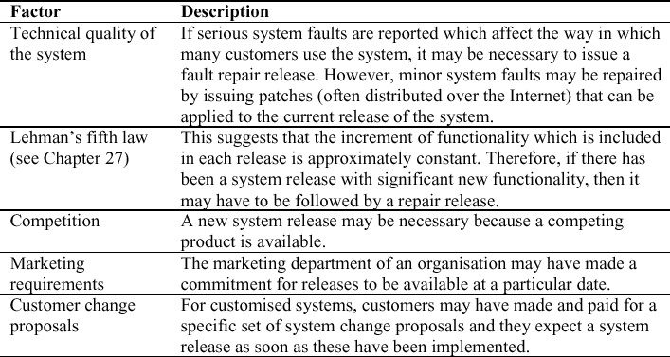
System release strategy

Slide 41
Release creation
Release creation involves collecting all files and documentation required to create a system release
Configuration descriptions have to be written for different hardware and installation scripts have to be written
The specific release must be documented to record exactly what files were used to create it. This allows it to be re-created if necessary

Slide 42
System building
The process of compiling and linking software components into an executable system
Different systems are built from different combinations of components
Invariably supported by automated tools that are driven by ‘build scripts’

Slide 43
System building problems
Do the build instructions include all required components?
When there are many hundreds of components making up a system, it is easy to miss one out. This should normally be detected by the linker
Is the appropriate component version specified?
A more significant problem. A system built with the wrong
version may work initially but fail after delivery
Are all data files available?
The build should not rely on 'standard' data files. Standards
vary from place to place

Slide 44
System building problems
Are data file references within components correct?
Embedding absolute names in code almost always causes
problems as naming conventions differ from place to place
Is the system being built for the right platform
Sometimes must build for a specific OS version or hardware configuration
Is the right version of the compiler and other software tools specified?
Different compiler versions may actually generate different code and the compiled component will exhibit different behaviour

Slide 45
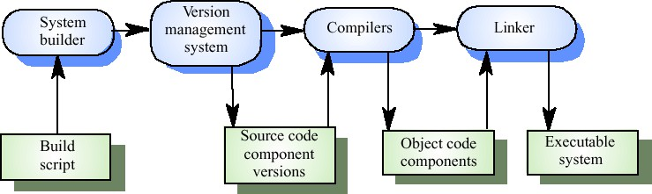
System building

Slide 46
System representation
Systems are normally represented for building by specifying the file name to be processed by building tools. Dependencies between these are described to the building tools
Mistakes can be made as users lose track of which objects are stored in which files
A system modelling language addresses this problem by using a logical rather than a physical system representation

Slide 47
CASE tools for configuration management
CM processes are standardised and involve applying pre-defined procedures
Large amounts of data must be managed
CASE tool support for CM is therefore essential
Mature CASE tools to support configuration management are available ranging from stand- alone tools to integrated CM workbenches

Slide 48
Change management tools
Change management is a procedural process so it can be modelled and integrated with a version management system
Change management tools
Form editor to support processing the change request forms
Workflow system to define who does what and to automate
information transfer
Change database that manages change proposals and is linked to a VM system

Slide 49
Version management tools
Version and release identification
Systems assign identifiers automatically when a new version is submitted to the system
Storage management.
System stores the differences between versions rather than all the version code
Change history recording
Record reasons for version creation
Independent development
Only one version at a time may be checked out for change. Parallel working on different versions

Slide 50
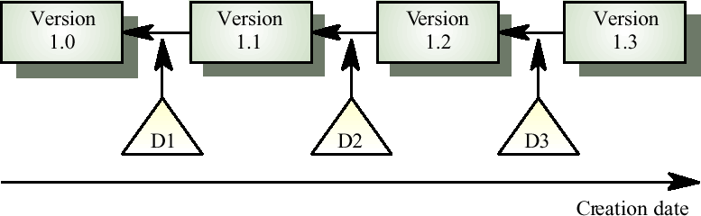
Delta-based versioning

Slide 51
System building
Building a large system is computationally expensive and may take several hours
Hundreds of files may be involved
System building tools may provide
A dependency specification language and interpreter
Tool selection and instantiation support
Distributed compilation
Derived object management

Slide 52
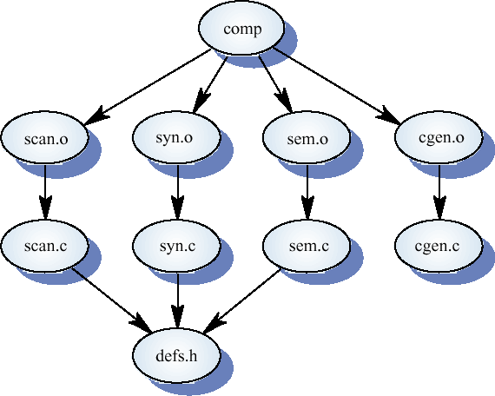
Component dependencies

